Slide 1
Key words
Interference 干涉
Huygens’ principle 惠更斯原理
Propagation 传播
Wave-front 波前
Wavelet 子波
Wavelength 波长
Index of Refraction 折射率
Phase difference 相位差
Optical path difference 光程差
Medium 介质
Vacuum 真空
Double-Slit interference 双缝干涉
Interference pattern 衍射图样
Illuminate 照射
Incident入射的
Monochromatic 单色光
Bright/ Dark Fringe 亮/暗条纹
Central maximum 中心极大
Second side maxima 第二极大
Coherence/ Incoherence 相干/非相干
Intensity 光强
Thin film interference 薄膜干涉
Reflection phase shifts反射相位突变
Transmission透射
Michelson’s Interferometer 迈克耳孙干涉仪

Slide 2
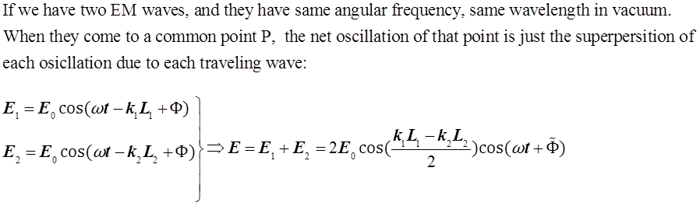
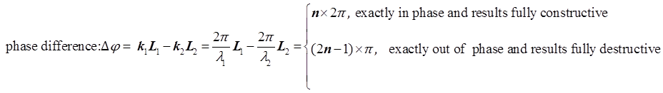
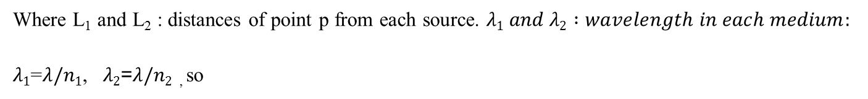

Review of Ch35 EM wave & Inference
From chapter 33, we know light is EM wave, it can be described by wave equation:

Slide 3

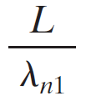
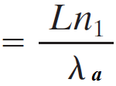

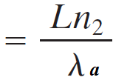
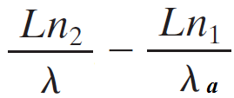
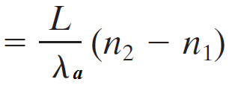
Review of Ch35 Phase difference
λ_{a}
n₁
λ_{a}
n₂
L
wavelength
in vacuum/air
refractive index
No. of wavelength N₁ in medium 1 ：
say, if it is 3.6
we take the decimal fraction, i.e. 0.6, ϕ=1.2π
No. of wavelength N₂ in medium 2 ：
Optical path Difference
Phase difference between the waves ϕ：
a
Optical path

Slide 4
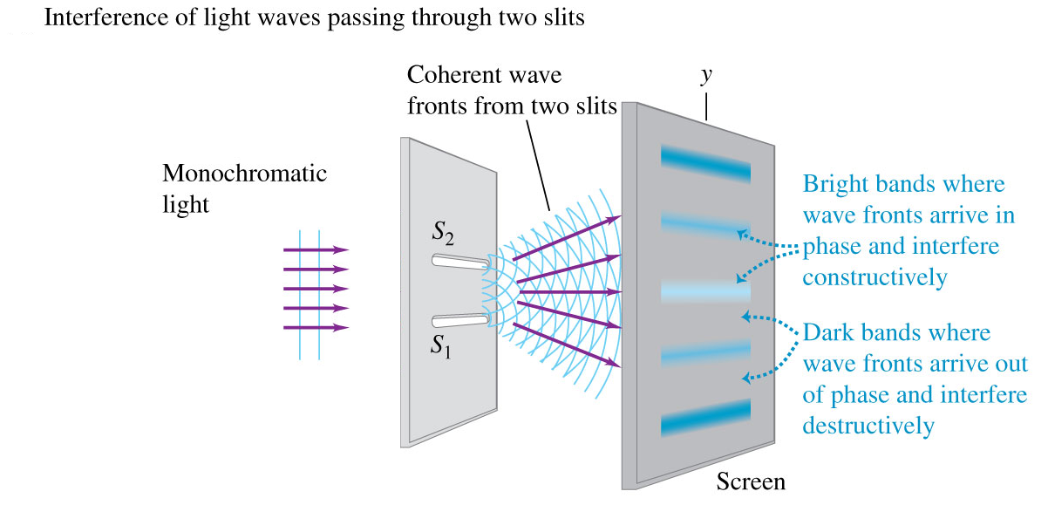
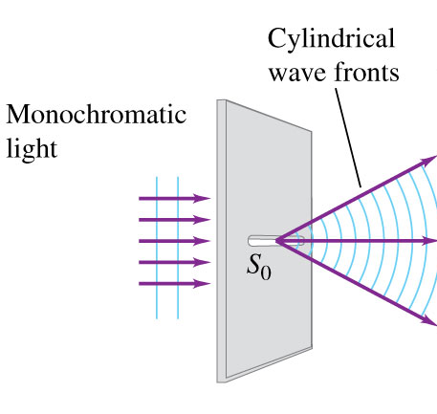
Review of Ch35
~ 1 μm wide
~ 1 μm wide
~ 100 μm or further apart
~ 1m
Notes:
This is the basic arrangement of two-slit interference experiment, here S0 can be considered as a combination of point sources, and the spherical wave emitted by the point sources reaches to the two slits, because the distances between each slit and S0 are same, so the oscillation at s1 and s2 are exactly in phase. Then we considered the two-slit as two point sources. And these two point sources are exactly in phase. We use rays r1 and r2 to represent the two waves, and when they come to the common point on the screen, a phase difference is present because of different path, so a interference pattern is present on the screen.
So the key point is to find the path length difference. Here, please noticed that, the slits separation is about 100um, and the slit-screen separation is about 1m, that means ,L/d is about 10 thousands. So this angle can be considered to be zero, and the two path can be approximated to be parallel to each other, at angle theta to the central axis., then we the path length difference is just this distance dsin(theta)

Slide 5
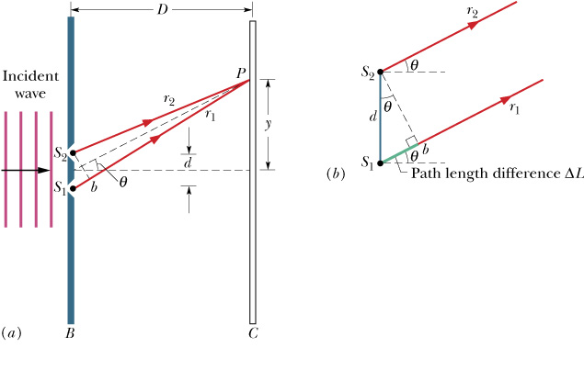
Review of Ch35
Path Length Difference:
Maxima-bright fringes:
Minima-dark fringes:
Second order bright fringe Second side maximum
Second order dark fringe
Second minimum
Notes:
Usually, the d is much larger the m lepta, at this case, the angle theta is a much smaller then 1, then sin~tan ~theta, then we can simplify our calculation, but when d is compared to m time lapta, you can not use this approximation. Those are Qualitative description, and actually, we want some quantitative calculation.

Slide 6
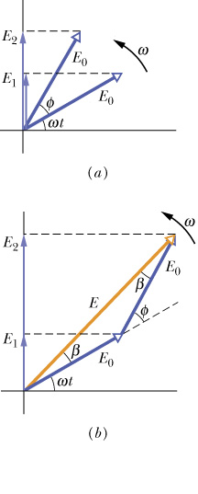


Review of Ch35 Intensity in Double-Slit Interference
m λ = d sinθ
Notes:
In chapter 31, we use phasor to represent a ac voltage, at here we also can use phasor to describe E field, the magnitude of the phasor is the amplitude and this angle is wt, as time go on, the phador rotate about the origin with angular speed w. the two E fields at point p have same E0 same w but constant a phase difference, which is related by the path length difference.
So the net magnitude of E is just this length.

Slide 7
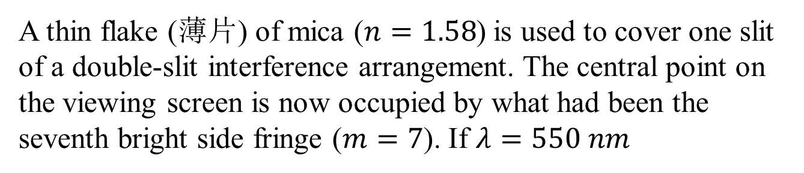
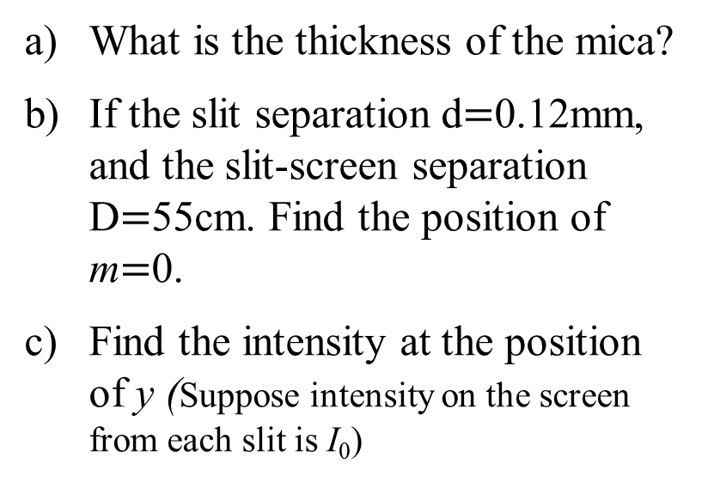
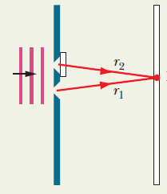
Problem 1
Notes:
Without this thin flake, the central point should be a maximum, we call central maximum, and the phase difference at this point is exactly zero.
The path difference of the two rays is always zero at this point. But now it is occupied by what had been the 7th bright side fringe, what does this sentence mean?
The optical path length difference should be 7 lepata, or the phase difference should be 7 times 2pi, and the phase difference only results from the difference of medium.
This is ray1 and this is ray2, this is the flake, initially, ray1 go through the flake with width L, but ray2 go through the air with same length L, so the phase difference between them is
nL-L, and then the two rays travelling into the air with same length reach to the central point, so we have:
M=0, means the phase difference is 0, so the phase difference results from path length difference should equal the phase difference results from the mica (medium)
so we have:

Slide 8
Review of Ch35 Interference (干涉)
a) At the center point, m=7, so the optical difference at the center point is：
b)
At the point of m=0, the optical differece is 0

Slide 9
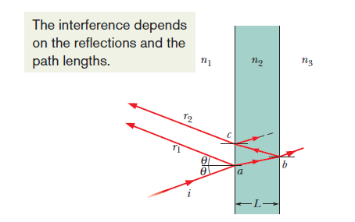





Review of Ch35 Interference from Thin Films
Reflection phase shift:
No phase change
No phase change
Phase change, 0.5wavelength
For constructive interference :
if L << λ
we can ignore the thickness of the film. And it always results destructive interference as the phase difference is always 1/2
For destructive interference :
Notes:
Now, if we have a film, and the width of film is of the order of magnitude of the wavelength, then interference will be present in your eyes when you see it.
We only consider the small incident angle case, that is theta in this figure is almost 0. A ray is incident on the front of the film, the reflection ray just come out the film directly, but the refraction ray come into the film and then reflected by the bottom of film, through the film again and then come out. The two rays come to a common point, your eyes and interfere to each other.
Bright or dark determined by the phase difference of the two rays, which comes from two ways:
1, the path length difference，compared to ray 1, ray 2 come into the film and then reflected and then come out the film, so 2L path length difference in the film
2, the phase change due to the reflection
So the 2L-

Slide 10
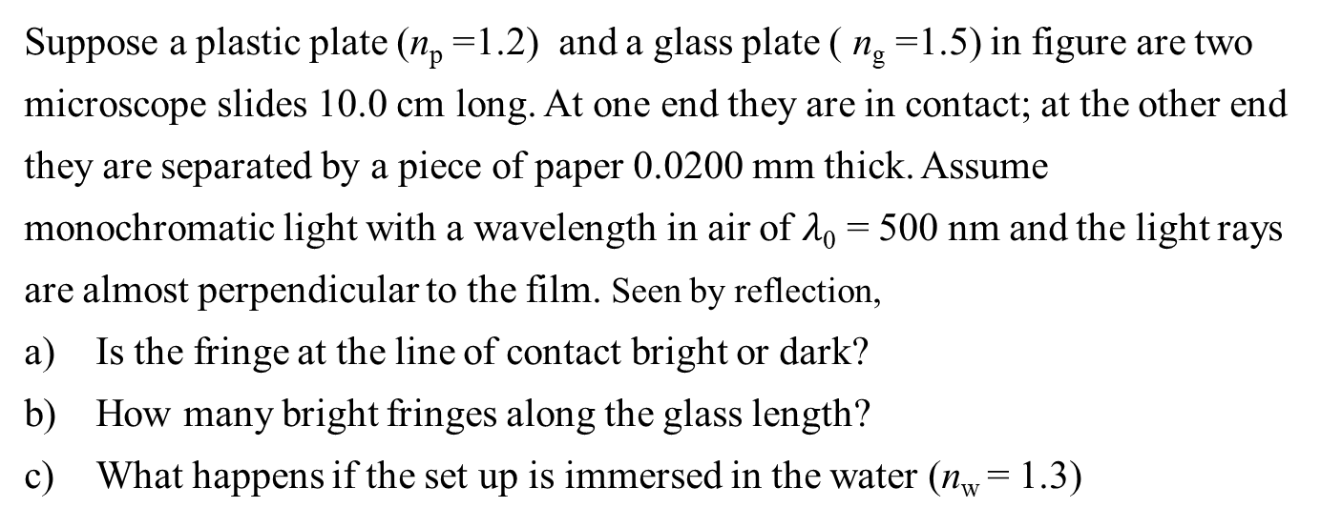
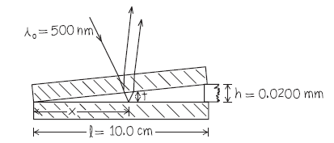

Problem 2
n_{a} = 1.0
n_{p} = 1.2
n_{g} = 1.5

Slide 11
Problem 2
We’ll consider only interference between the light reflected from the upper and lower surfaces of the air wedge between the microscope slides. [The top slide has a relatively great thickness, about 1 mm, so we can ignore interference between the light reflected from its upper and lower surfaces]. The wave reflected from the lower surface undergoes a π rad phase change while the wave reflected from the upper surface does not.
a) At the line of contact, the thickness of the wedge is 0, so the phase difference between the two rays is π, thus there is a dark fringe at the line of contact.
b) At a place where the thickness of the wedge is d, the condition for a maximum intensity is:
Since the first bright fringe corresponds to m = 0, m = 79 corresponds to the 80 bright fringes.

Slide 12
Problem 2
c) Now we need consider the interference pattern formed by waves reflected from the upper and lower surfaces of the water wedge. The wave reflected from the lower surface undergoes a π rad phase change and the wave reflected from the upper surface also undergoes anther π rad phase change.
At the line of contact, the thickness of the wedge is still 0, but the two rays now are in phase, thus there is a bright fringe at the line of contact.
At a place where the thickness of the wedge is d, the condition for a maximum intensity now should be:
Since the first bright fringe corresponds to m = 0, m = 104 corresponds to the 105 bright fringes.

Slide 13
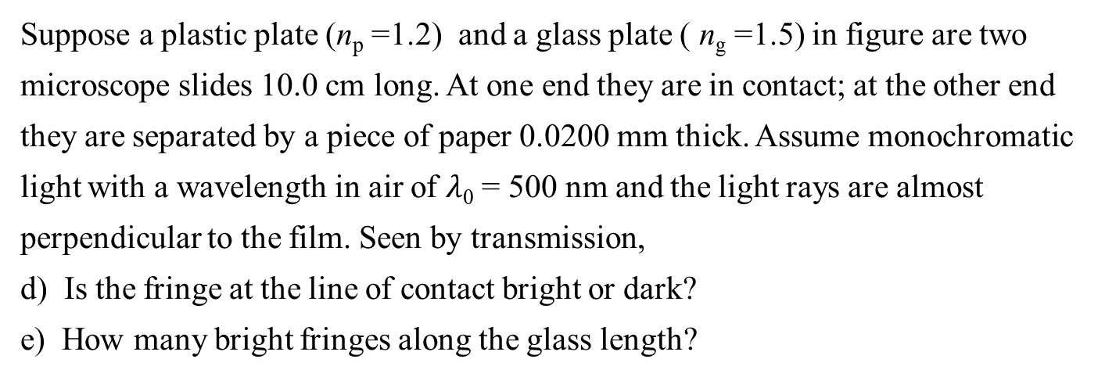




Problem 2

Slide 14
Problem 2
Now we need consider the interference pattern formed by waves transmitted from the lower surfaces of the air wedge. As shown in figure, the wave transmitted directly (ray 1)from the lower surface has no phase change and the ray 2 has phase change two times.
d) At the line of contact, the thickness of the wedge is still 0, but the two rays now are in phase, thus there is a bright fringe at the line of contact.
e) At a place where the thickness of the wedge is d, the condition for a maximum intensity now should be:
Since the first bright fringe corresponds to m = 0, m = 80 corresponds to the 81 bright fringes.

Slide 15
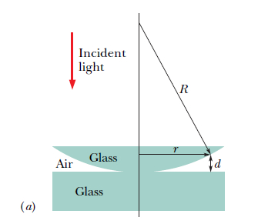
Problem 3
Figure a shows a lens with radius of curvature R lying on a flat glass plate and illuminated from above by light with wavelength λ. Figure b (a photograph taken from above the lens) shows that circular interference fringes (called
Newton’s rings) appear, associated with the variable thickness d of the air film between the lens and the plate. Find the radii r of the interference maxima. Assuming
.

Slide 16
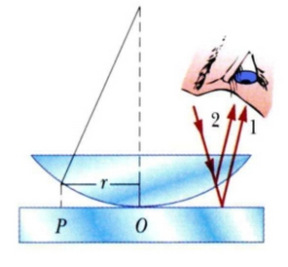
Problem 3
Consider the interference pattern formed by waves reflected from the upper and lower surfaces of the air wedge. The wave reflected from the lower surface undergoes a π rad phase change while the wave reflected from the upper surface does not. At a place where the thickness of the wedge is d, the condition for a maximum in intensity is
2d = (m + 1/2)λ

Slide 17
Problem 3
If the radius of curvature R of the lens is 5.0 m and the lens diameter is 18mm.
How many bright rings are produced? Assume that λ= 589nm
How many bright rings would be produced if the arrangement
were immersed in water (n=1.33)?

Slide 18
Problem 3
a)
Since the first bright fringe corresponds to m = 0, m = 27 corresponds to the 28 bright fringe.
b)
We now replace λ by λ_{n} = λ/n_{w}
This corresponds to the 37 bright fringe.

Slide 19
Problem 3
c) If the radii of the mth and (m+20)th bright rings are measured and found to be 0.162 and 0.368 cm, respectively, in light of wavelength λ = 546 nm.
Calculate the radius of curvature of the lower surface of the lens
when m is changed to m + 20, r becomes r', so

